Slide 1

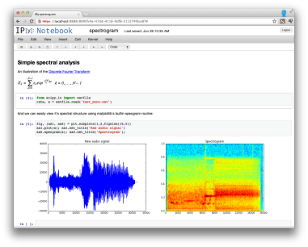



Architecture Diagram: “Zinvestor”
Raw Data
Data Storage
SQLite
Data Munging/Wrangling
Computation and Analysis
(e.g. Create New Variables)
Statistical Modeling
Data Ingestion
Python API Requests
Presentation
Zip code Data

